Slide 1
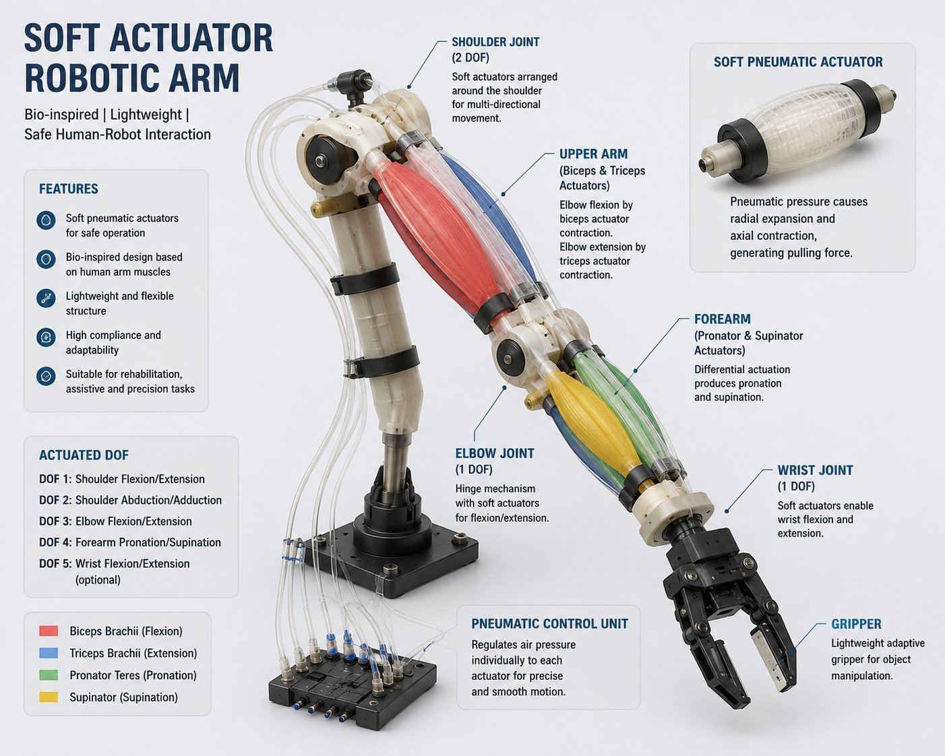
Soft Actuator Robotic Arm Atharv Nagvekar [RBT23ME069] Under guidance of :- Arvind Bansode (Sc-E)
Soft Actuator : Soft actuators mimic biological muscles by producing motion through deformation rather than rigid mechanical joints. They are lightweight, flexible, compliant, and capable of safe interaction with humans and unstructured environments.
Key Features:
Flexible and lightweight
Muscle-like contraction and extension
High compliance and adaptability
Safe for human–robot interaction
Can be actuated using pneumatic, hydraulic, electrical, or smart materials

Slide 2
Robotic Arm
A soft actuator robotic arm uses flexible and deformable actuators to produce movement by mimicking the contraction and relaxation of human muscles. These actuators can bend, expand, contract, or twist to generate motion. Different actuators can represent muscles such as the biceps for flexion and triceps for extension. Soft robotic arms are lightweight, flexible, and safer for human interaction than conventional rigid robotic systems. They can also adapt to different shapes and environments due to their compliant structure. Soft actuator robotic arms have applications in rehabilitation, prosthetics, assistive devices, medical robotics, and human–robot interaction.

Slide 3
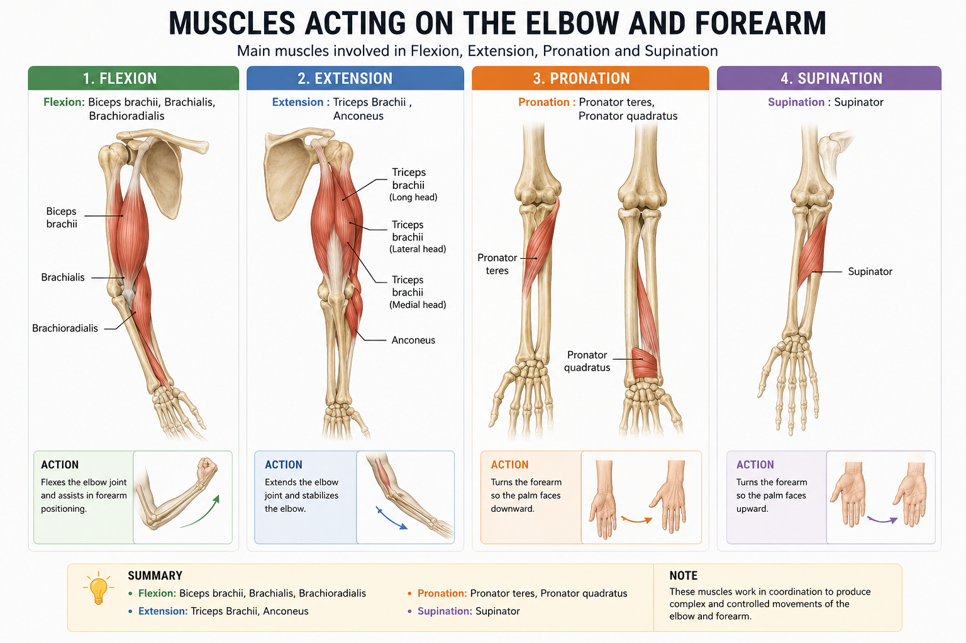
Muscle involved in this movements
Flexion: Biceps brachii, Brachialis, Brachioradialis,
Extension : Triceps Brachii , Anconeus
Pronation : Pronator teres, Pronator quadratus
Supination : Supinator

Slide 4
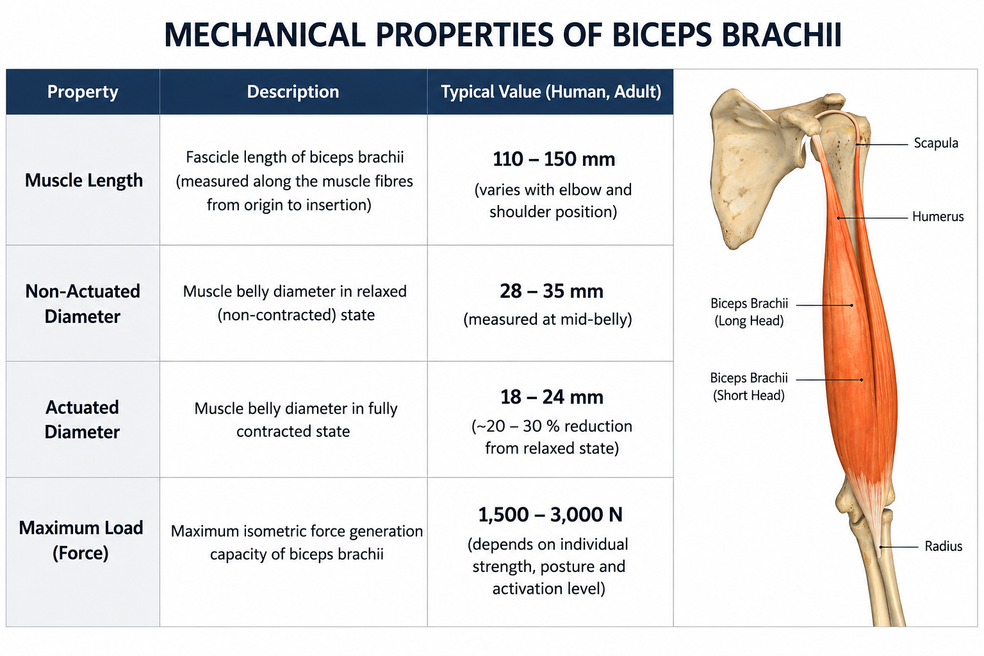
Biceps brachii

Slide 5
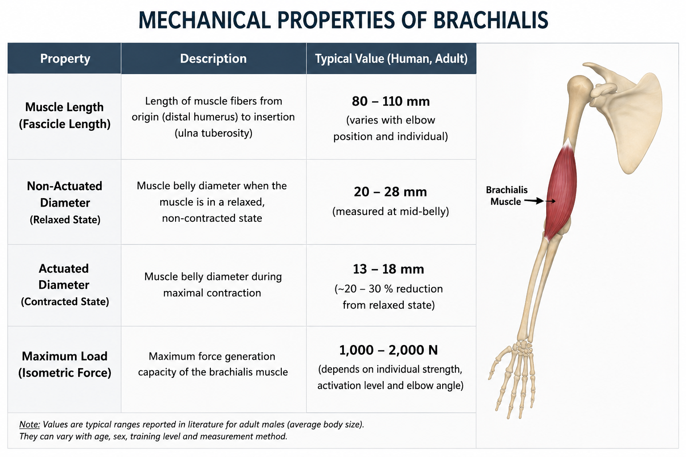
Brachialis

Slide 6
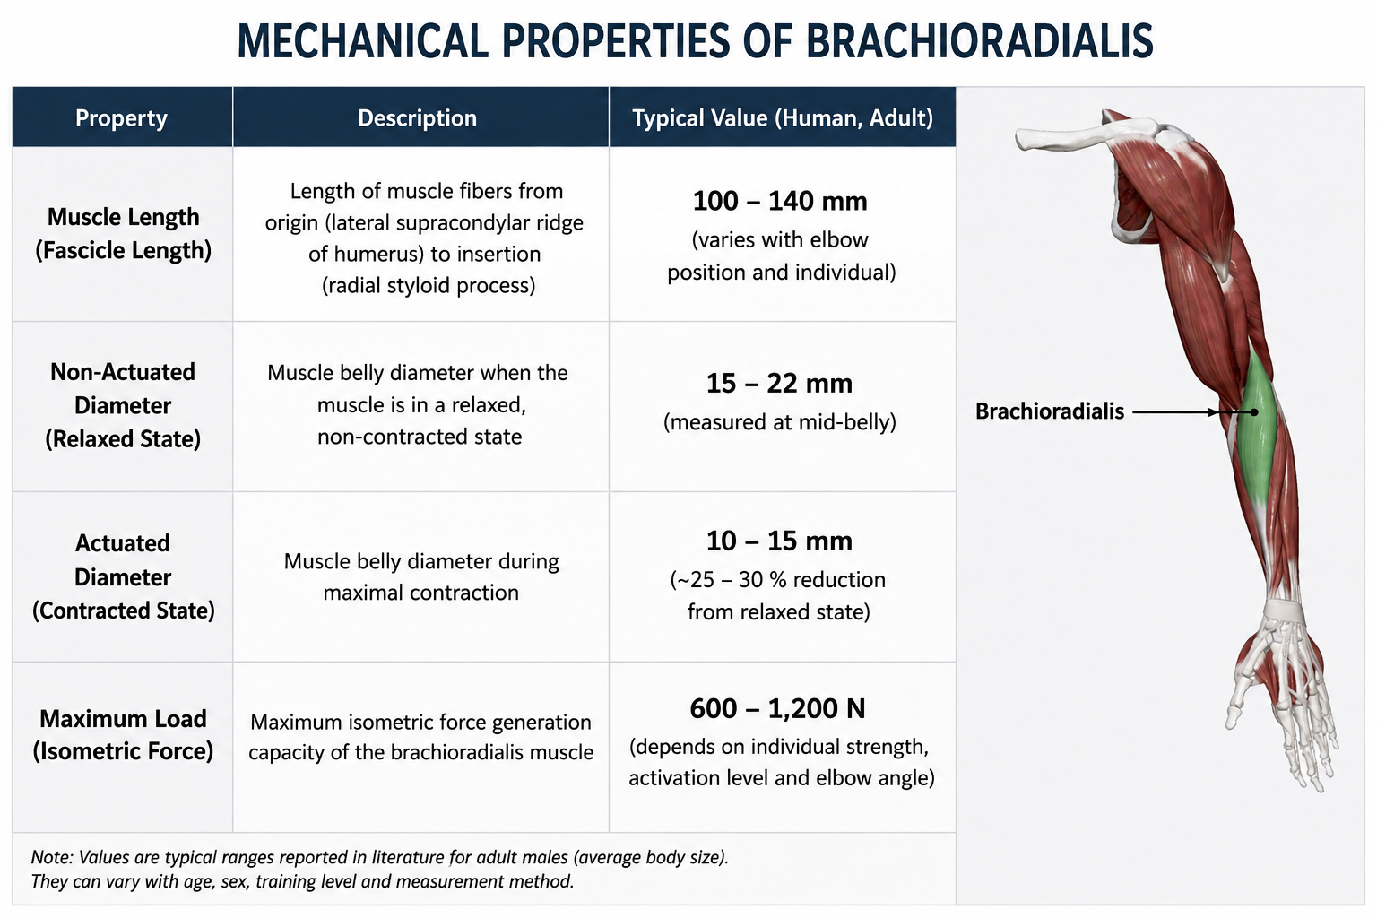
Brachioradialis

Slide 7
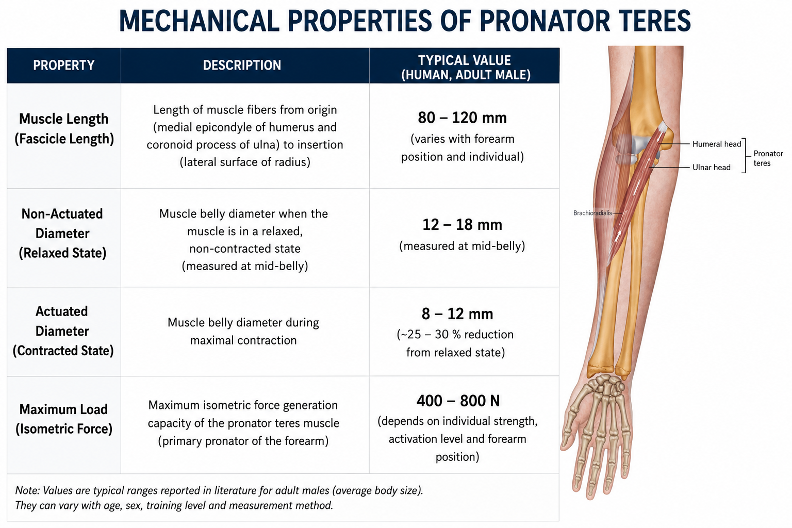
Pronator Teres

Slide 8
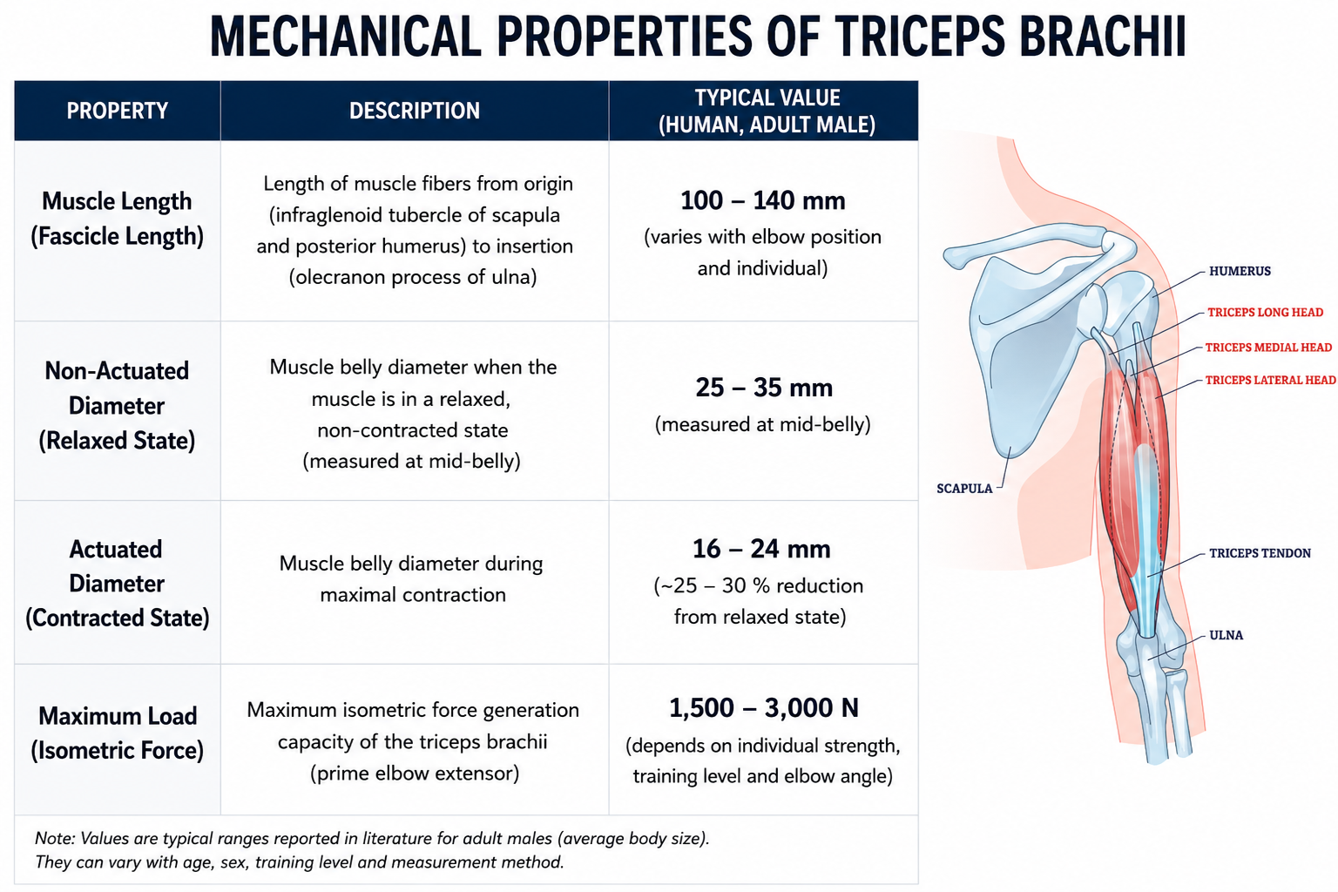
Triceps Brachii

Slide 9
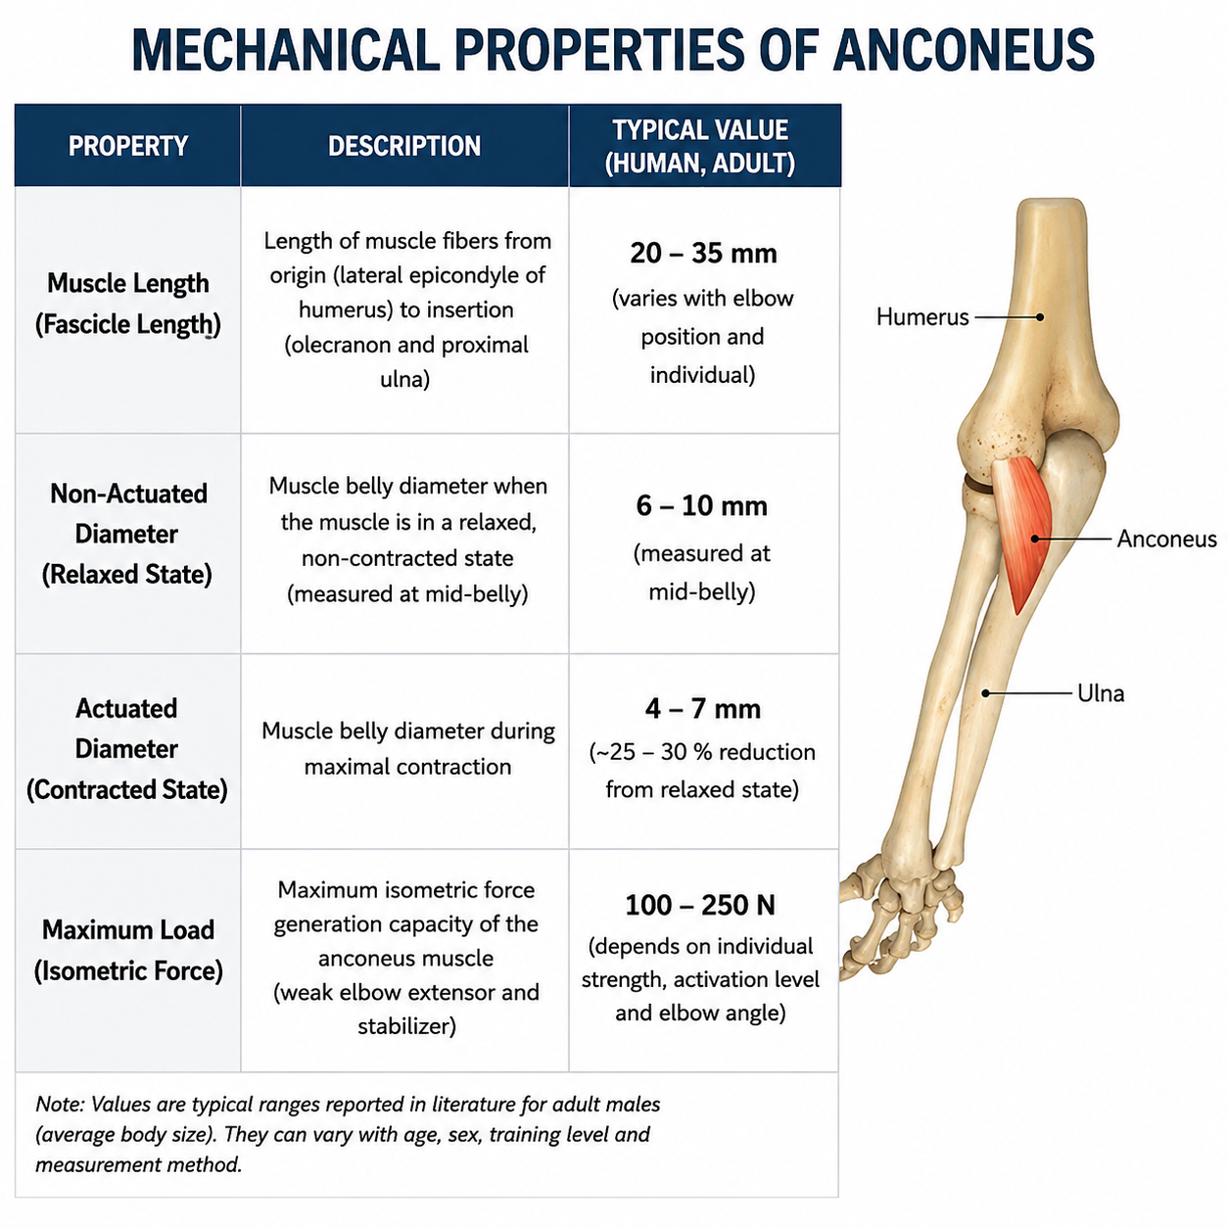
Anconeus

